Slide 1
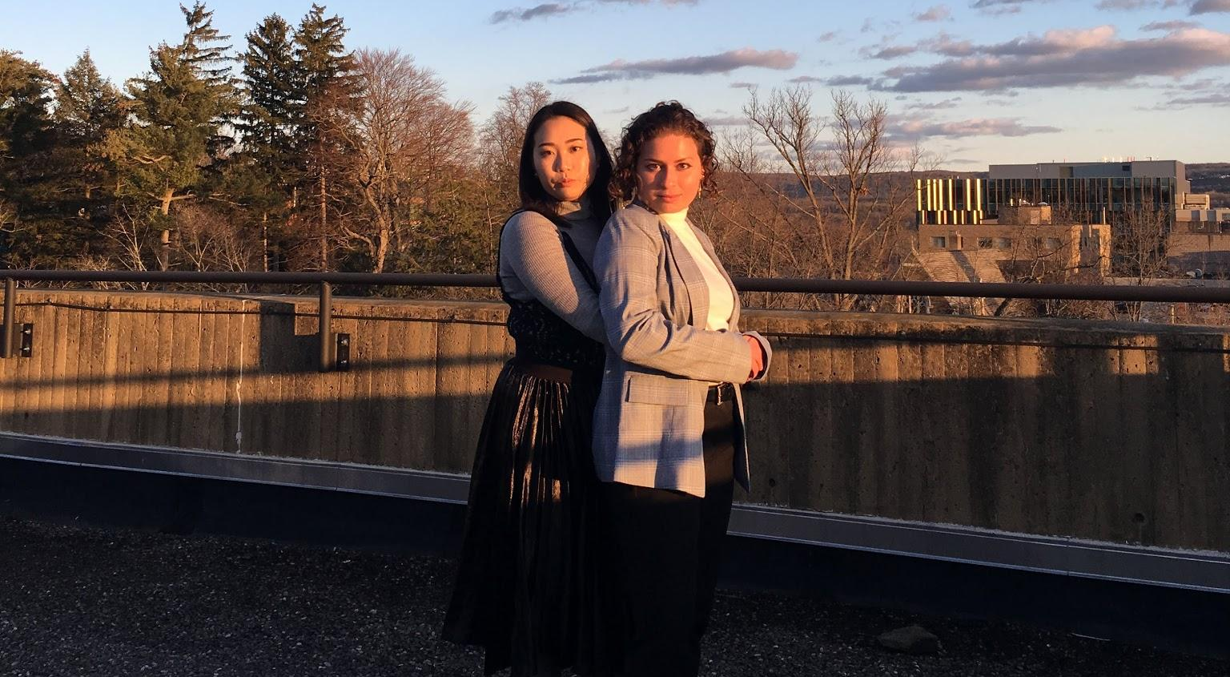
Zoe and Cynthia Try Their Best:
A Comedic Endeavor in Four Parts

Slide 2
Do not have high expectations. We will only fail you.

Slide 3
Disclaimer
We are not culpable for any discomfort you may have found over the course of this experience. SHould you find yourself in physical pain, please consult a physician or send us a GitHub issue and we will respond to you within 3-5 business days. There is no reimbursement for the cost of your ticket(s). All complaints can be sent directly to our attorneys at large (Clare E O’Connor, CEO45). Any fanmail can be sent to our PO address (remember, no flammables please, we had an incident last week and we would like the culprit who is at large to come forward. We will not be pressing charges, we think. We are just deeply disturbed.)We are not culpable for any discomfort you may have found over the course of this experience. SHould you find yourself in physical pain, please consult a physician or send us a GitHub issue and we will respond to you within 3-5 business days. There is no reimbursement for the cost of your ticket(s). All complaints can be sent directly to our attorneys at large (Clare E O’Connor, CEO45). Any fanmail can be sent to our PO address (remember, no flammables please, we had an incident last week and we would like the culprit who is at large to come forward. We will not be pressing charges, we think. We are just deeply disturbed.)We are not culpable for any discomfort you may have found over the course of this experience. SHould you find yourself in physical pain, please consult a physician or send us a GitHub issue and we will respond to you within 3-5 business days. There is no reimbursement for the cost of your ticket(s). All complaints can be sent directly to our attorneys at large (Clare E O’Connor, CEO45). Any fanmail can be sent to our PO address (remember, no flammables please, we had an incident last week and we would like the culprit who is at large to come forward. We will not be pressing charges, we think. We are just deeply disturbed.) For any insurance claims, please tear them up as we have no assets worth taking. If you want to take this material you can as it is free and open source, found on our GitHub repository: https://github.com/CynthiaTChan/talent_show.

Slide 4
This was our only option given that we have no “performable” (???) talents.

Slide 5


Slide 6

We will provide you with a comedic surreal experience.
And maybe a chuckle along the way !
Thoughtful
Thinking worse of us
Reflective
Deeply unsettled

Slide 7
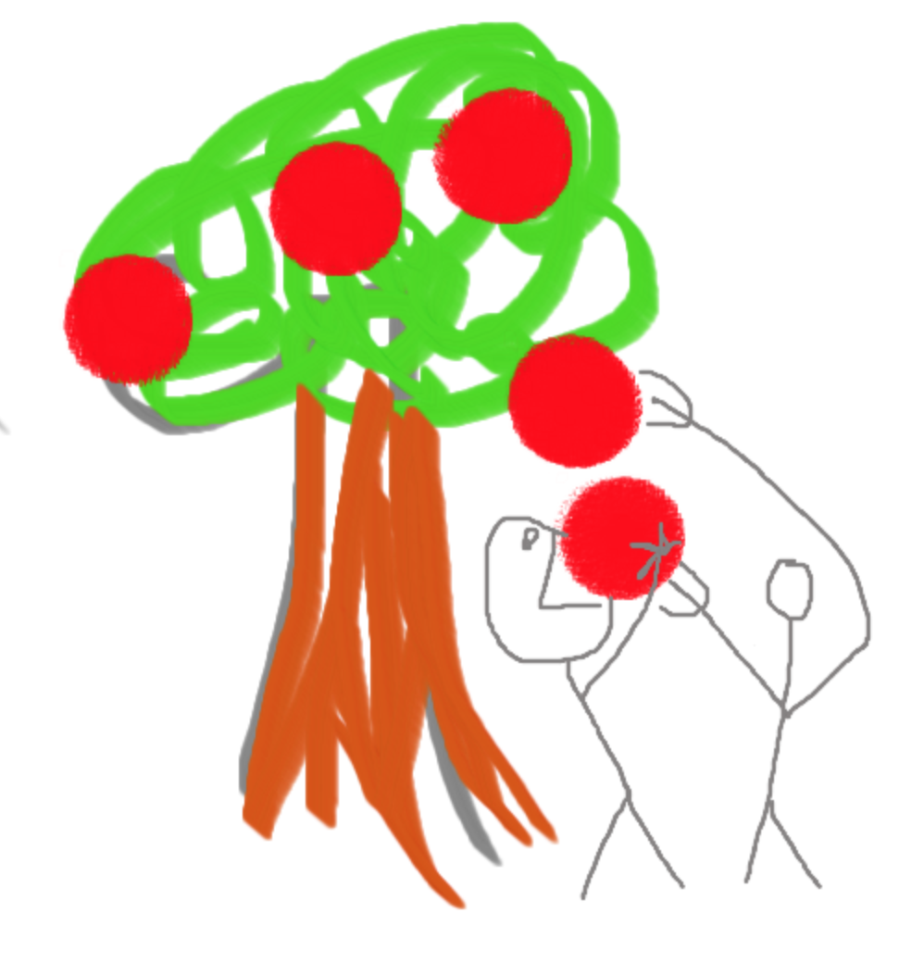
“Slideshow is the lowest form of humor” - CLARF (5/7/18 5pm)

Slide 8
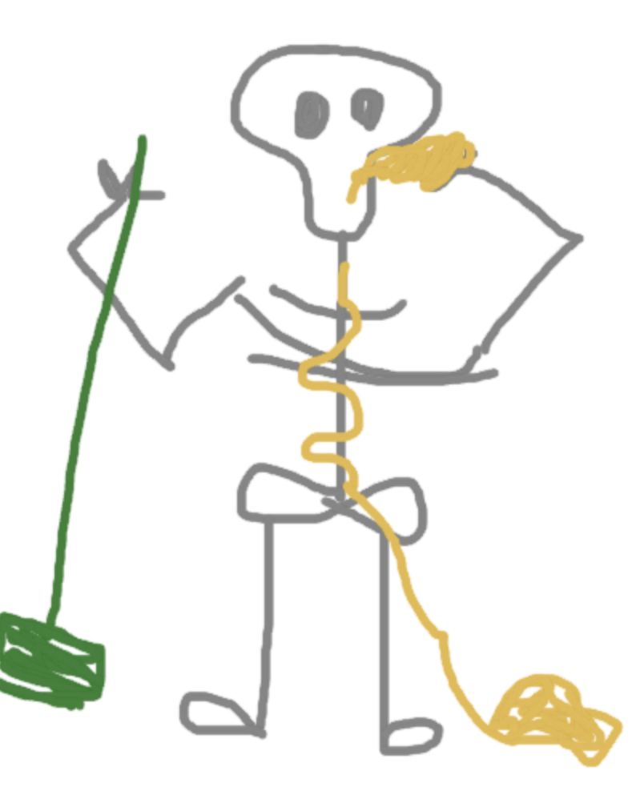
Rapid Mix: High quality, gravity fed.
A skeleton walks into a bar.
He says, can I have a beer and a mop.

Slide 9
Rapid Mix: High quality, gravity fed.
Why was 6 afraid of 7?
A buccaneer!
How much does it cost a pirate to get their ears pierceD?
Because 7 8 9. heheh
I lava you.
What did one volcano say to the other?
It waves!
How do we know the ocean is friendly?

Slide 10
Flocculation

Slide 11
Sedimentation
How come "abbreviated" is such a long word?

Slide 12

Filtration
Cynthia
Zoe

Slide 13


A good-bye, farewell, and secular dinner prayer song
Earth who gives to us this food
Sun who makes it ripe and good
Dearest Earth and dearest Sun
Many thanks for what you’ve done

Slide 14
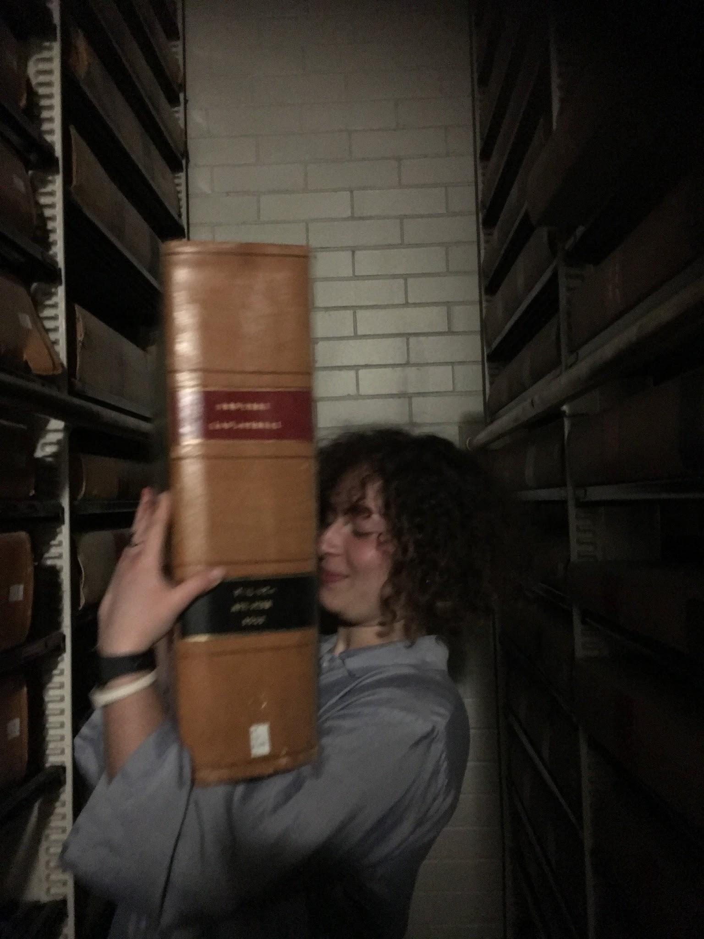
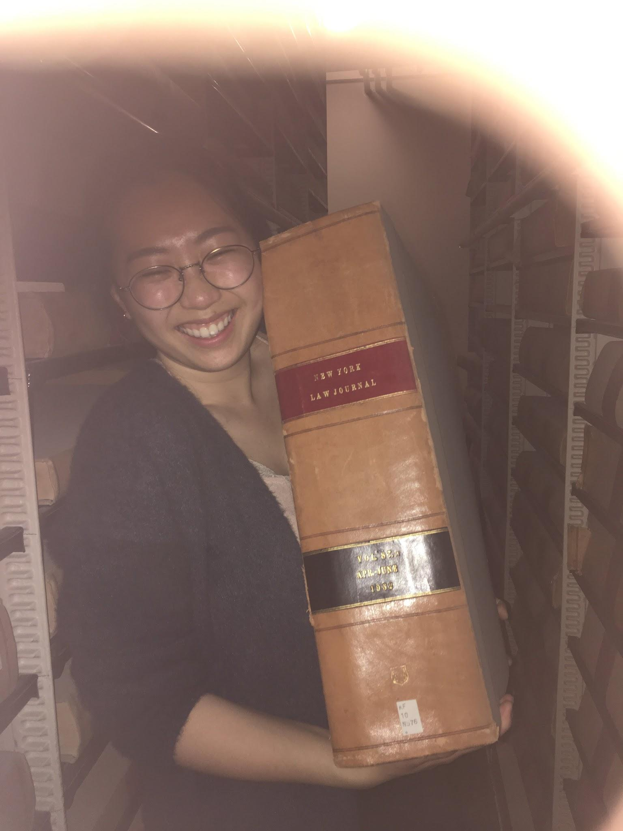
Thanks for listening! Enjoy the rest of the show! Thanks AguaClara Fam!

Slide 15
Disclaimer
We are not culpable for any discomfort you may have found over the course of this experience. SHould you find yourself in physical pain, please consult a physician or send us a GitHub issue and we will respond to you within 3-5 business days. There is no reimbursement for the cost of your ticket(s). All complaints can be sent directly to our attorneys at large (Clare E O’Connor, CEO45). Any fanmail can be sent to our PO address (remember, no flammables please, we had an incident last week and we would like the culprit who is at large to come forward. We will not be pressing charges, we think. We are just deeply disturbed.)We are not culpable for any discomfort you may have found over the course of this experience. SHould you find yourself in physical pain, please consult a physician or send us a GitHub issue and we will respond to you within 3-5 business days. There is no reimbursement for the cost of your ticket(s). All complaints can be sent directly to our attorneys at large (Clare E O’Connor, CEO45). Any fanmail can be sent to our PO address (remember, no flammables please, we had an incident last week and we would like the culprit who is at large to come forward. We will not be pressing charges, we think. We are just deeply disturbed.)We are not culpable for any discomfort you may have found over the course of this experience. SHould you find yourself in physical pain, please consult a physician or send us a GitHub issue and we will respond to you within 3-5 business days. There is no reimbursement for the cost of your ticket(s). All complaints can be sent directly to our attorneys at large (Clare E O’Connor, CEO45). Any fanmail can be sent to our PO address (remember, no flammables please, we had an incident last week and we would like the culprit who is at large to come forward. We will not be pressing charges, we think. We are just deeply disturbed.) For any insurance claims, please tear them up as we have no assets worth taking. If you want to take this material you can as it is free and open source, found on our GitHub repository: https://github.com/CynthiaTChan/talent_show.

